Slide 1
Building GUIs and Generating Generative Videos
Rashed

Slide 2
Agenda
Elevating demos with GUIs
Intro to Popular GenAI UI Libraries
Intro to GenAI image/video generation
Sora first look
Sora’s edges
Hands-on lab

Slide 3
Telling Engaging Stories via Graphics
[“category1”:{
“series1”:4.3,
“series2”:3.4,
“series3”:2.0
},
“category2”:{
“series1”:2.5,
“series2”:4.4,
“series3”:2.0
},
“category3”:{
“series1”:3.5,
“series2”:1.8,
“series3”:3.0
},
“category4”:{
“series1”:4.5,
“series2”:2.8,
“series3”:5.0
}]

Slide 4
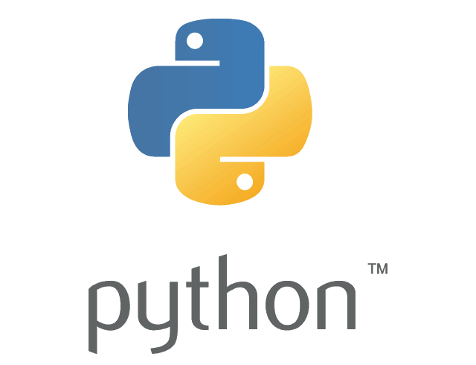



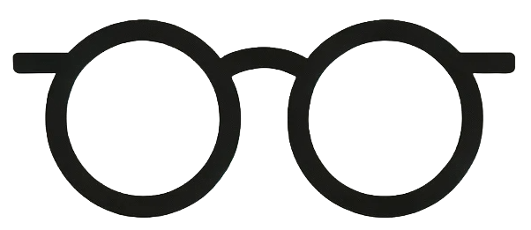
What are our options?

Slide 5
Streamlit
Pros
Cons
Fast to prototype data-centric apps with Python alone—no front-end knowledge needed.
Large, active community with extensive documentation and tutorials.
Intuitive syntax and wide range of built-in UI components.
Excellent for data visualization and interactive data science dashboards.
Limited flexibility for complex, multi-page, or highly customized UIs.
Not well-suited for non-Python environments or general web development.
Can become slow with large data or heavyweight backend processes.
Advanced customizations or integrations often require workarounds or third-party tools.
Off-the-shelf UI is visually generic and less brandable out of the box.

Slide 6
Chainlit
Pros
Cons
Tailored for conversational UIs and LLM (Large Language Model) apps—specialized integration.
Extremely fast setup for chatbots and natural language workflows using Python.
Balances ease of use with some UI customization capability for conversation flows.
Built-in streaming of model responses for interactive user experience.
Lightweight and modern workflow for iteration.
Niche: not designed for generic dashboards or non-LLM use cases.
Small but growing community; less documentation and resources.
UI customization is more limited versus general frameworks.
Steeper learning for those new to LLM/inference pipelines.
Less flexible for arbitrary layouts or complex, non-conversational user experiences.

Slide 7
Gradio
Pros
Cons
Easiest way to create interfaces for ML models—minimal code for quick demos.
Supports diverse input/output types (text, image, audio, video, sketch, etc.).
Auto-generates shareable links and public endpoints—great for quick stakeholder feedback.
Integrates easily into Jupyter, Colab, or plain Python scripts.
Consistently updated, with growing industry adoption.
Niche: not designed for generic dashboards or non-LLM use cases.
Small but growing community; less documentation and resources.
UI customization is more limited versus general frameworks.
Steeper learning for those new to LLM/inference pipelines.
Less flexible for arbitrary layouts or complex, non-conversational user experiences.

Slide 8
Build it Yourself
Pros
Cons
Easiest way to create interfaces for ML models—minimal code for quick demos.
Supports diverse input/output types (text, image, audio, video, sketch, etc.).
Auto-generates shareable links and public endpoints—great for quick stakeholder feedback.
Integrates easily into Jupyter, Colab, or plain Python scripts.
Consistently updated, with growing industry adoption.
Niche: not designed for generic dashboards or non-LLM use cases.
Small but growing community; less documentation and resources.
UI customization is more limited versus general frameworks.
Steeper learning for those new to LLM/inference pipelines.
Less flexible for arbitrary layouts or complex, non-conversational user experiences.

Slide 9
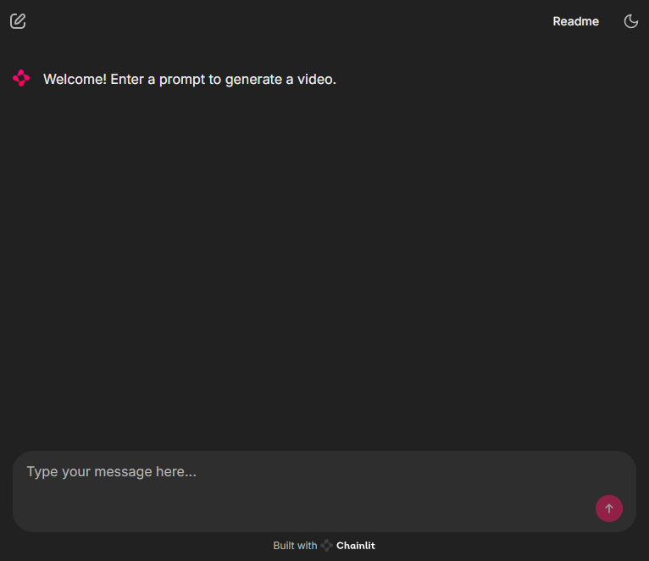

Today we’ll use Chainlit

Slide 10

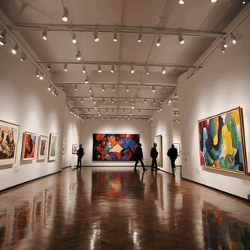
From text to video
Diffusion Transformers for video
Starting with pure “noise” and removing that noise such that it minimizes loss that’s guided by attention (the prompt) until an image is revealed. This image then gets turned noisy and it attempts to remove that noise to reveal the next image hidden underneath. These images are stitched together to form a video.
Excellent summary: Diffusion Transformer Explained | Towards Data Science

Slide 11
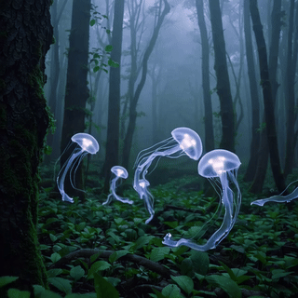
Sora
A diffusion transformer model for making up to 20s videos at up to 1080p

Slide 12
Edges of Sora to be aware of
Physical Simulations
Time & Space
Prompt Interpretation
Technical & Quality
Struggles to accurately simulate complex physical interactions.
Misses cause and effect.
Spatial confusion – especially relative to objects/characters.
Temporal inaccuracies.
Loses persistence and consistency of objects, characters, or scenes.
Cannot process nuanced or complex prompts (multi-sentence usually gets ignored).
Lack of fine-grain controls.
Limited resolution and limited aspect ratios.
Limited to 20seconds maximum. The long the video, the lower the narrative’s cohesion.
No copyright protection.
Notes:
P1. water, fire, or intricate action sequences may not behave as expected according to real-world physics
P2. Biting a cookie and the cookie comes out whole or a bite of cereal and the spoon still has cereal.
T1.Sora sometimes misinterprets spatial instructions, such as distinguishing between “left” and “right,” or understanding precise relative positions of objects and characters.
T2. The model can struggle with prompts requiring complex, time-dependent events, like tracking a precise camera movement or a sequence of actions unfolding step-by-step.
T3. Keeping a character’s appearance or the visual style consistently the same across scenes or shots, especially when a character temporarily leaves the frame, is still challenging P1. The model may miss subtleties in highly detailed or nuanced prompts, especially if the request involves rare or ambiguous concepts. P2. Users can’t always guide the model with fine precision regarding motion, expressions, or detailed scene layout. Q1. 360, 360), (640, 360), (480, 480), (854, 480), (720, 720), (1280, 720), (1080, 1080), (1920, 1080) Q2. Recommend to stay around 5-7 seconds.
Q3. Can ask for things like CocaCola. Sometimes some characters will get replaced with others – possible glitch with an attempt at copyright protection.

Slide 13
Edges of Sora to be aware of
Physical Simulations
Time & Space
Prompt Interpretation
Technical & Quality
Struggles to accurately simulate complex physical interactions.
Misses cause and effect.
Spatial confusion – especially relative to objects/characters.
Temporal inaccuracies.
Loses persistence and consistency of objects, characters, or scenes.
Cannot process nuanced or complex prompts (multi-sentence usually gets ignored).
Lack of fine-grain controls.
Limited resolution and limited aspect ratios.
Limited to 20seconds maximum. The long the video, the lower the narrative’s cohesion.
No copyright protection.
PREVIEW
Notes:
P1. water, fire, or intricate action sequences may not behave as expected according to real-world physics
P2. Biting a cookie and the cookie comes out whole or a bite of cereal and the spoon still has cereal.
T1.Sora sometimes misinterprets spatial instructions, such as distinguishing between “left” and “right,” or understanding precise relative positions of objects and characters.
T2. The model can struggle with prompts requiring complex, time-dependent events, like tracking a precise camera movement or a sequence of actions unfolding step-by-step.
T3. Keeping a character’s appearance or the visual style consistently the same across scenes or shots, especially when a character temporarily leaves the frame, is still challenging P1. The model may miss subtleties in highly detailed or nuanced prompts, especially if the request involves rare or ambiguous concepts. P2. Users can’t always guide the model with fine precision regarding motion, expressions, or detailed scene layout. Q1. 360, 360), (640, 360), (480, 480), (854, 480), (720, 720), (1280, 720), (1080, 1080), (1920, 1080) Q2. Recommend to stay around 5-7 seconds.
Q3. Can ask for things like CocaCola. Sometimes some characters will get replaced with others – possible glitch with an attempt at copyright protection.

Slide 14
Break

Slide 15

Scenario & Build
The Use Case
Architecture
Major fast food restaurant’s media team wants to generate videos for social media campaigns. The videos can either be used directly after minor brand edits or be used for inspiration by the team.
Requirements:
6 seconds long
Resolution for most mobile devices
- No copyright/branding violations

Slide 16
Hands-on
Notes:
JeIIueQkYZdJQQJ99BCAC8vTInXJ3w3AAABACOGm5pR

